Slide 1

Istituto per Servizi di Ricovero e Assistenza agli Anziani

Slide 2

What is ISRAA
ISRAA is an Italian public senior care provider based in Treviso.
We have knowledge and experience in assisting seniors to remain independent, by promoting positive feelings in an age-friendly environment.

Slide 3
Our numbers
4
nursing homes
2
day-care centers
+750 employees:
850
350
12
residents
carers
GPs
90
21
Care managers
32
nurses
flats for autonomous
17
physical rehabilitation trainers
seniors
1000
seniors in home care
30
psychologists

Slide 4









FABER is the European Department of ISRAA
The innovation focus is about:
digitalisation of health and social care services for older adults;
new forms of inclusion;
social innovation;
longevity and active ageing;
AFE and senior housing.
www.fabbricaeuropa.eu
E-mail: faber@israa.it
TEN - Treviso Europa Network

Slide 5




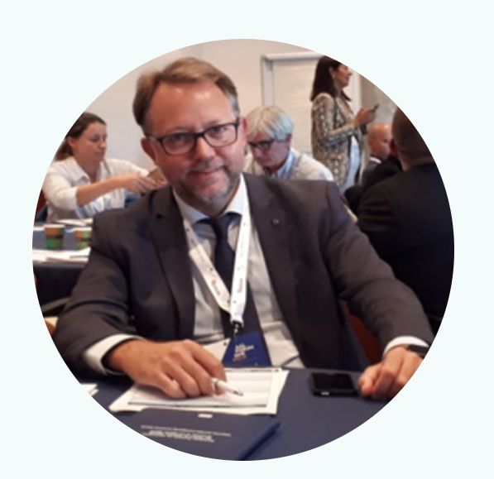




TEAM
DAVIDE TUIS
STEFANIA MACCHIONE
SARA CERON
FRANCESCA MASIERO
OSCAR ZANUTTO
NICOLA CONTARIN
ADELE DE STEFANI
MARTA MATTARUCCO
GIADA COCCHETTO

Slide 6










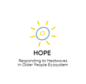



Among our EU projects:
RESIL4CARE– (Erasmus +)
SEFAC - (3° Health Programme)
PA4AGE – (Erasmus +)
E.CA.R.E - (Interreg IT-AT)
Socatel Twinning – (Digital Health Europe)
ENACT - (Horizon 2020)
WISELIFE- (Erasmus +)
VALUECARE - (Horizon 2020)
PRAGRESS – (Erasmus+)
SHES - (Erasmus +)
Earlydem - (Erasmus +)
SUPER – (Erasmus+)
niCE Life - (Interreg CE)
HOPE – (Erasmus+)
TAAFE - (Interreg Alpine Space)
IDEAHL – (CSA- Horizon 2020)

Slide 7


Among our EU projects 2023:
PROCAREFUL – (Interreg CE)
AFECO - (Erasmus + )
DEDALUS – (Horizon Europe)
ITOSA – (Erasmus + )
DYNAMO – (PCP Horizon Europe)
CONVIDA + – (Erasmus + )
SIRENE – (CSA Horizon Europe)

Slide 8
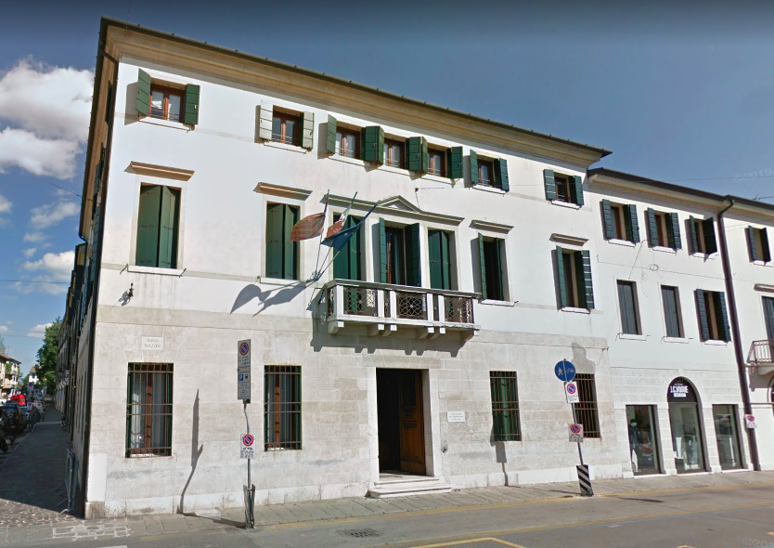
ISRAA
Borgo G. Mazzini, 48,
31100
Treviso (TV)
ITALY
Tel.: +39 0422 4146
email: info@israa.it / pec: israa@pec.it

Slide 9
Good Practice 1: Borgo Mazzini Smart Co-housing
ISRAA owns a real estate in the centre of Treviso that includes flats, shops and a former nursing home located in an ancient monastery..
In this area we want to face the new challenge of economic, social and demographic change promotinga urban regeneration and providing housing, gardens and outdoor spaces for ageing in place.
The goal is offering a new social and sustainable response to the elderly way of living and housing in the centre of the city.
We have designed a group of indipendent, accessible and affordable flats to rent in a smart, inclusive and age friendly neighborghood close to a network of services.
Our commitment is to promote and empower the elderly’s ability to remain in their own home for as long as possible and to foster self-determination.

Slide 10

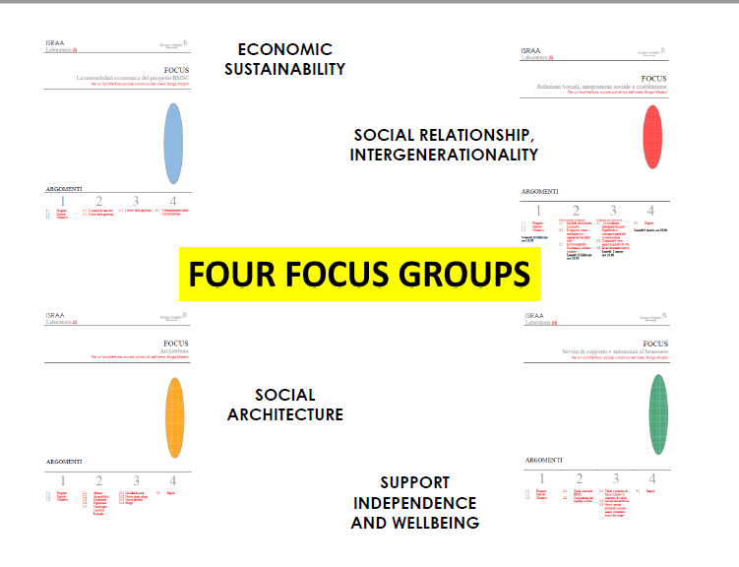
How did we come up with it?

Slide 11
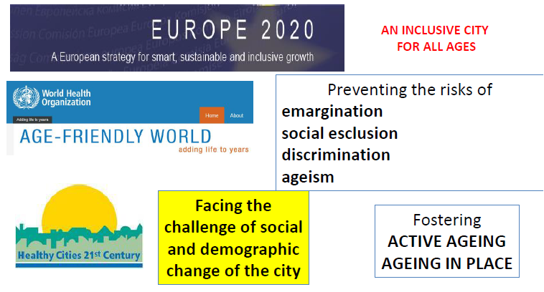
Focus: social relationships
In an age-friendly city, policies, services, settings and structures support and enable people to age actively by:
•recognizing the wide range of capacities and resources among older people;
•anticipating and responding flexibly to ageing-related needs and preferences;
•respecting their decisions and lifestyle choices;
•protecting those who are most vulnerable;
•And promoting their inclusion in and contribution to all areas of community life.

Slide 12
Focus: support independence and wellbeing
The resident makes himself/herself available to others, inside and outside the Borgo.
Family, friends, neighbourhood.
ISRAA provides services to foster active ageing and to take care for dependent elderly.
Volunteers.
The old town centre.
City Hall, Local Health Care System.
A community manager who is a member of the ISRAA team.
Elderly Advisory Council.
IMPORTANCE OF LOW-LEVEL SERVICES:
- housekeeping and maintenance
- laundry and linen
- Social-concierge services
- health promotion
- emergency call systems
- recreational and social activities
- social work services
- spiritual assistance

Slide 13
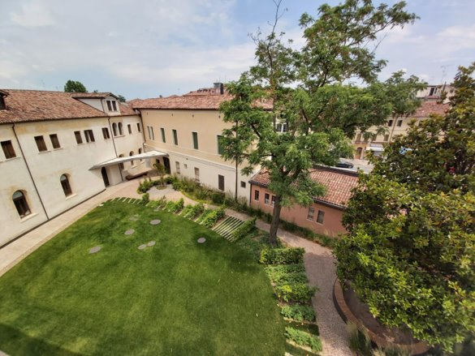
Focus: economic sustainability
Sustainability for both users and ISRAA
Real estate asset management governed by ISRAA
We offer flats to rent and services
Self-sustainability: BMSC Project is not a burden for other ISRAA users (no fee increasing)

Slide 14
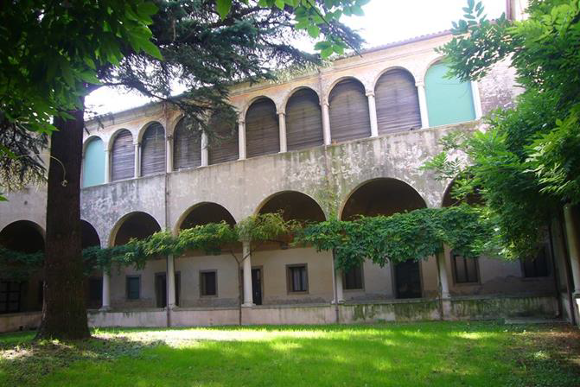
Focus: social architecture
ACCESSIBILITY
(ICF international classification of functioning disability and health)
•UNIVERSAL DESIGN
•MODULARITY AND HOUSING FLEXIBILITY
•TECHNOLOGY
•ECO-FRIENDLY AND SUSTAINABLE DESIGN
•ERGONOMY

Slide 15

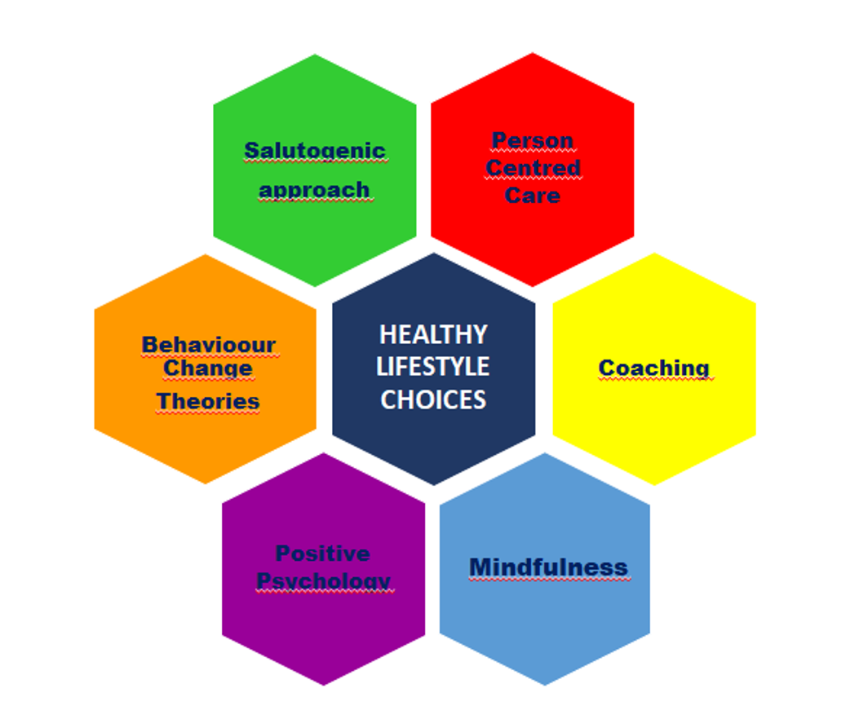
Good practice 2 – Mindfulness activities (SEFAC)
Promote healthy lifestyles, through mindfulness practices, increasing empowerment, promoting self-efficacy, and increasing self-management of participants regarding modifiable risk factors for the chronic diseases
Implement a local social engagement model tested successfully in the UK based on the volunteers’ recruitment and training for connecting social services, primary health care and social services and participants according to the toolkit guidelines.
Develop a SEFAC app, with which the participants can easily and quickly assess their health behaviour and that support people to adopt a healthier lifestyle, while getting remote support when needed.

Slide 16

Good practice 3: "Ogni vita è un capolavoro"

